Slide 1
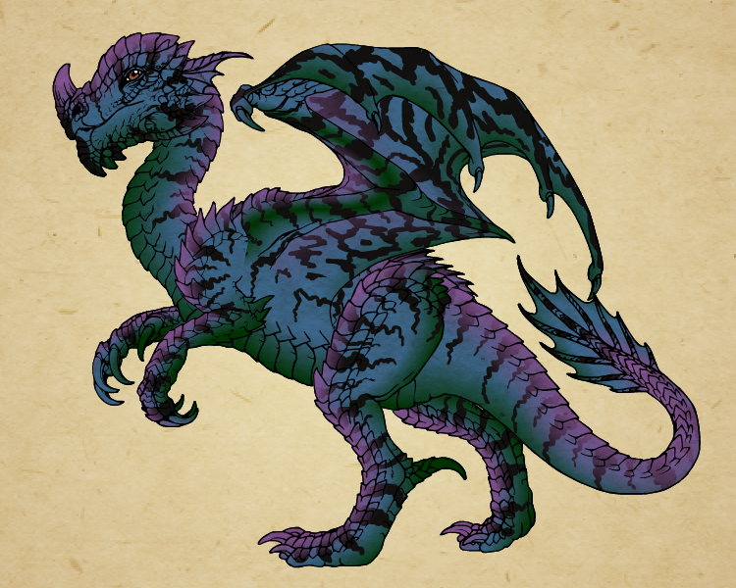
Dragon Genetics: Understanding Inheritance
SS
ee
0
Aa
Ww
Hh
For centuries humans have selected plant varieties and animals for specific traits.
Plant breeders select plant varieties which produce more seed or fruit
Livestock producers select animals with specific traits such as increased milk production, ample muscle mass or structural correctness
Dogs have been bred for physical traits like eyesight and speed, as well as personality traits such as aggression or friendliness
You have recently embarked on a career as a dragon breeder, and at one of the following stations, you will produce a baby dragon by simulating the processes by which parental genes are passed on to offspring.
Before you begin your first breeding project, please read through these pages, which have some information about your dragons, as well as a review of the basic concepts of inheritance.

Slide 2
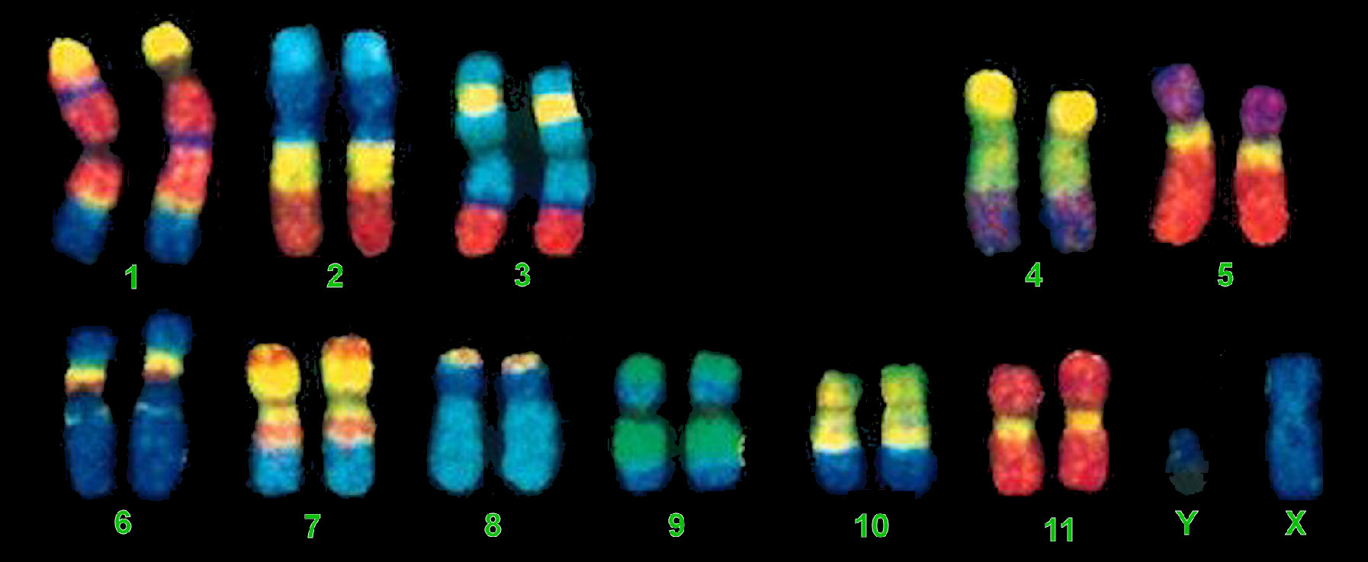
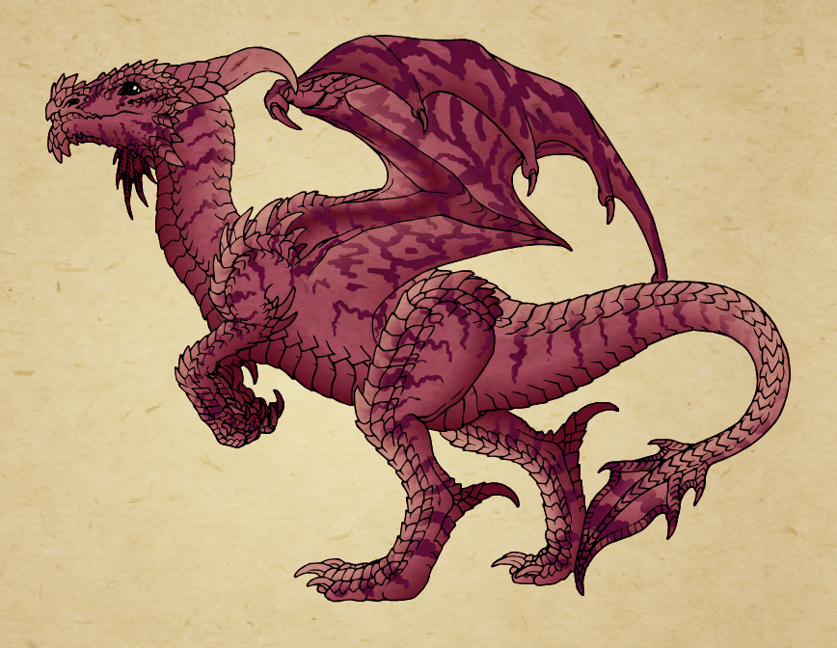
Dragon Genetics
Draconis siirexus is a species of dragon that has twelve sets of homologous chromosomes: eleven sets of autosomal chromosomes, and a pair of sex chromosomes (X & Y).
This species has several characters that are inherited according to the laws of inheritance we studied in class:
Body color
Stripes
Spots
Beard
Horns
Wings
External ear flaps
Inheritance
Heredity is the passing on of traits from parents to offspring. Most plants and animals have two of every kind of gene, one from their mother and one from their father.
Only one allele from each parent is passed to each offspring for a particular trait.
Alleles are forms of the same gene with small differences in their DNA sequence. These small differences contribute to each organism's unique physical features.
These physical features are called phenotypes.
The genetic makeup of an organism is its genotype.
Some alleles are dominant while others are recessive.
Dominant alleles are always expressed in offspring
Recessive alleles are only expressed in offspring if both parents contribute a recessive allele
For example, in humans, the allele for freckles is dominant.
Children who receive a “freckle” allele from either parent will exhibit the trait
Children who receive two recessive alleles will be freckle-less.
Now it’s your turn to see how inheritance works when breeding dragons, and understand how traits are passed on from one generation to the next.

Slide 3
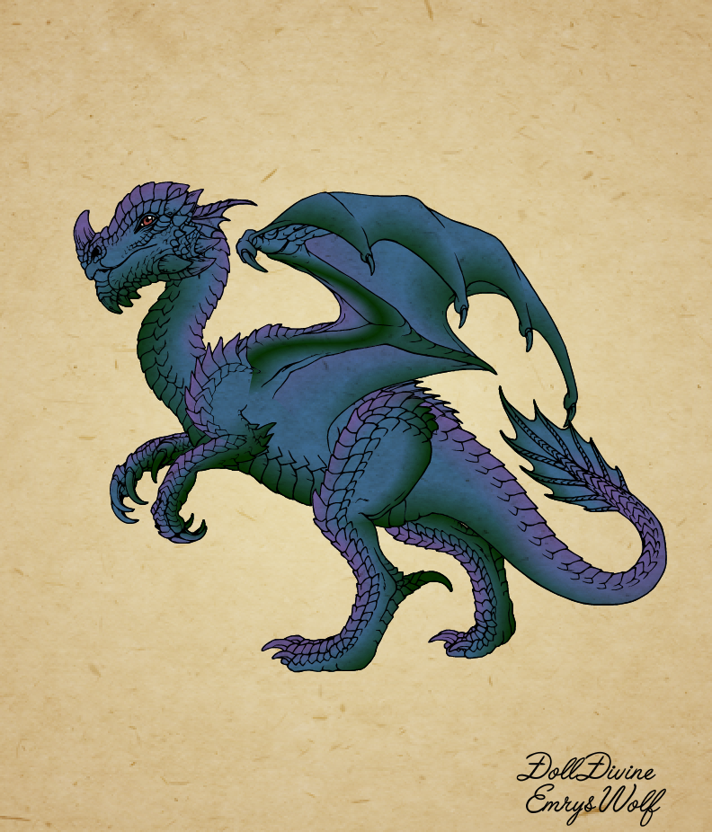
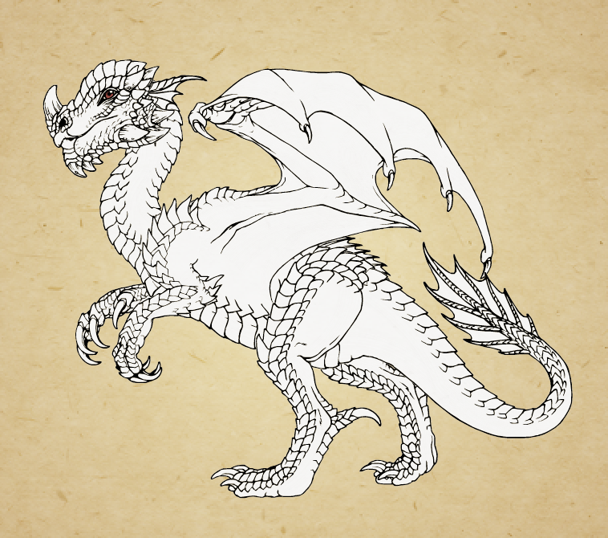
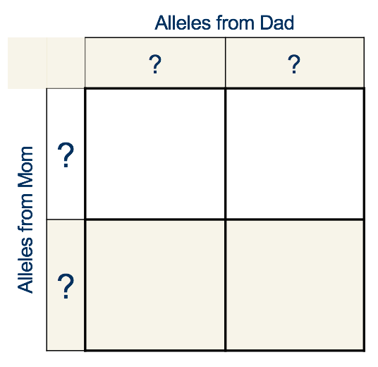
Station 4: Dragon Genetics - Punnett Squares
Part I: Albinism
AA or Aa
Tyrosinase is an enzyme involved in pigment production (in both dragons and humans). Dragons have a single gene that codes for the production of this enzyme, which in turn produces the pigments that give dragons their skin color.
The dominant allele (A) codes for a normal enzyme
The recessive allele (a) codes for a defective protein that will not produce the necessary enzyme
A dragon with the recessive condition (aa) will be albino with completely white skin.
aa
?
+ =
These two dragons are both heterozygous at this gene locus. We can use a Punnett square to determine the probability that this pair of dragons will have an albinistic offspring.
What is the probability that these two heterozygous dragons will produce an offspring with albinism?
Complete the Punnett Square in your worksheet
Aa
?
?
?
?

Slide 4
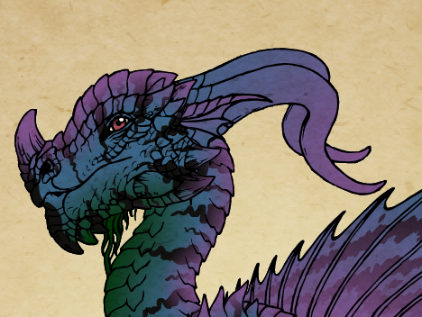
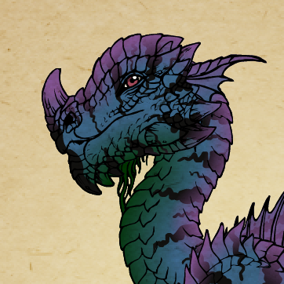
Polled or Horned?
In dragons, the allele that causes horns to grow from the rear of the skull is recessive. This means that the hornless, or “polled” allele is dominant.
P denotes a polled (hornless) allele
p denotes the allele for horns
If a horned adult mates with a polled dragon that is heterozygous for the P allele, what is the probability that these two parents will produce an offspring with horns?
 |  | Alleles from Dad
Alleles from Mom
What are the genotypes of the parents?
Fill in a Punnett square to determine the possible offspring.
What is the probability of these dragons having an offspring with horns?
? ?
? ?

Slide 5
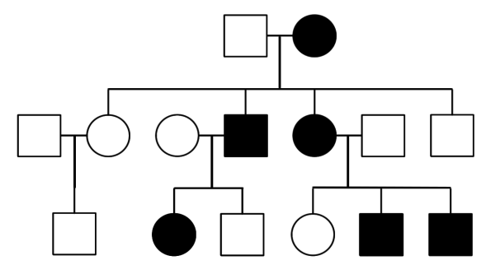
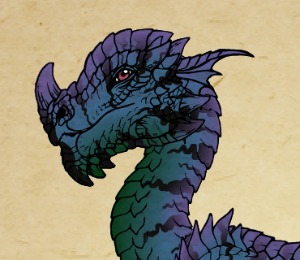
Stripes: Dominant or Recessive?
Station 5: Dragon Genetics - Pedigree Charts
Some dragons have stripes, while others do not. As a new breeder, you aren’t sure which is the dominant condition.
Based on the pedigree chart, are stripes (represented by the S allele) a dominant trait or a recessive one? (Hint: look to see if heterozygotes have the trait).
ss Ss
ss ss ss Ss Ss Ss ss
ss Ss ss ss SS Ss
Rules of pedigree charts:
Males are squares; females are circles
Filled in has trait; empty does not
Matings joined with horizontal line
Offspring joined with vertical lines

Slide 6
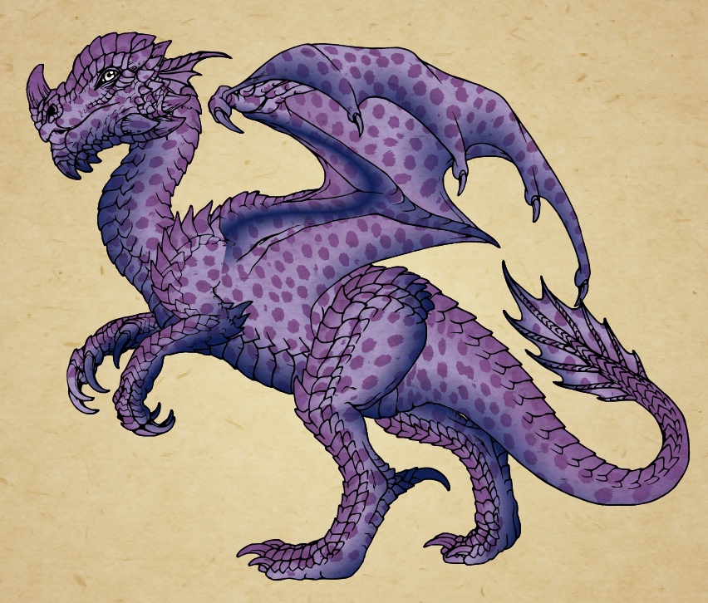
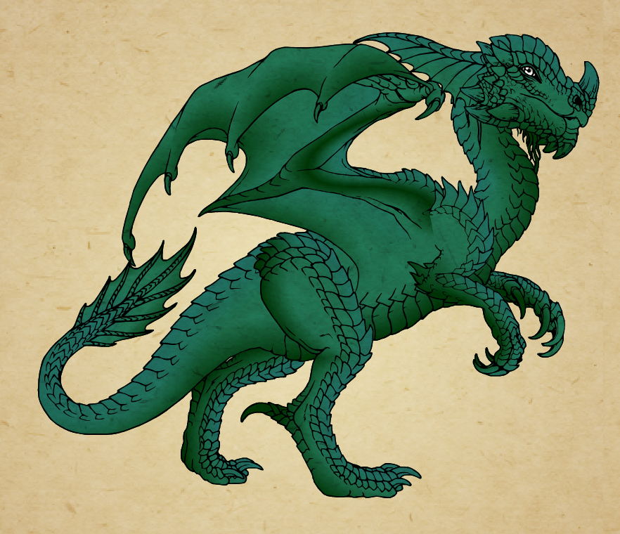
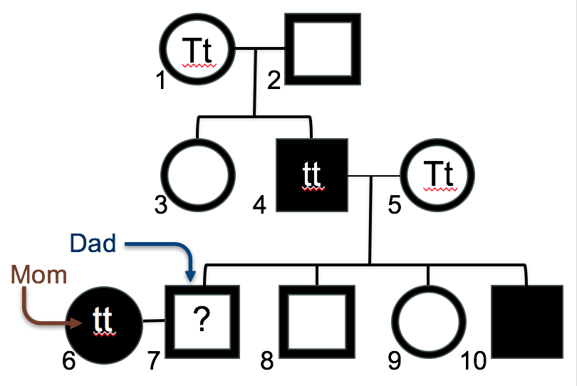
Spots or Not?
Having spots is an autosomal recessive trait, represented by the T allele. Can you determine whether two dragon parents are likely to have a spotted offspring?
The mother has spots and the father doesn’t, but you don’t know if he has one of the recessive alleles or not.
Below is a pedigree chart. You have been given the genotypes of a few of the dragons, but will have to deduce the others by their relationships with family members. Use this information to determine the father’s genotype, and whether or not he could produce a spotted offspring.
On your worksheet, fill in the missing genotypes.

Slide 7
Station 6: Breed a Baby Dragon
Finally it’s time to put your genetics skills to use! Follow these steps to breed your baby dragon:
Familiarize yourself with the inherited characters on the next page
Assume that both parents are heterozygous for all autosomal characters
Your baby dragon will inherit two alleles for every character – one from mom and one from dad. To ensure that fertilization is random, you’ll flip a coin to see which allele is inherited at each locus. (If you don’t have a coin handy, just google “flip a coin” and a cute random flip generator will appear).
Keep track of the alleles in the chart in your worksheet
Allele | Character | Genotypes | Sex-linked
A | Albinism | Pigmentation present (AA, Aa) No pigmentation; results in albino (aa) | No
Y^{B} |  | Beard present (XY^{B}) No alternate allele | Yes
E | Ear Flaps | Long external ear flaps (EE) Short external ear flaps (Ee) External ear flaps absent (ee) | No
X^{G} | Grounded (Wingless) | Normal wings (XGXG; XGXg, XGY) Wings absent (XgXg, XgY) | Yes
H | Horns | Rear horns (HH) Rear and nose horns (Hh) Nose horn (hh) | No
S | Stripes | Stripes present (SS, Ss) Stripes absent (ss) | No
T | Spots | Spots absent (TT, Tt) Spots present (tt) | No
W | Wings | Leathery wings (WW, Ww) Feathered wings (ww) | No
Note to breeders:
If albinism is present, no pigment is produced, therefore neither stripes nor spots will be present, regardless of genotype
If grounded condition is present, no wings or dorsal spines are produced, regardless of genotype.

Slide 8
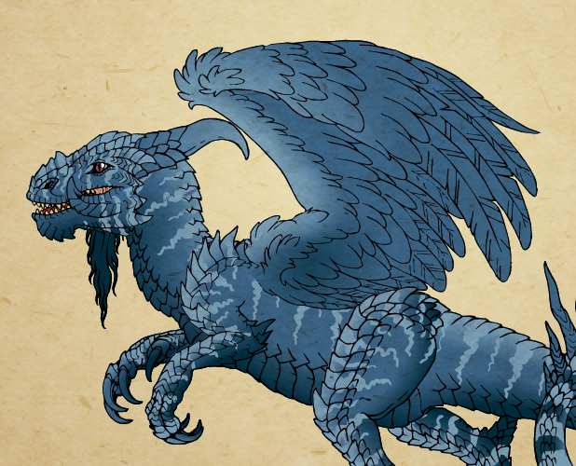
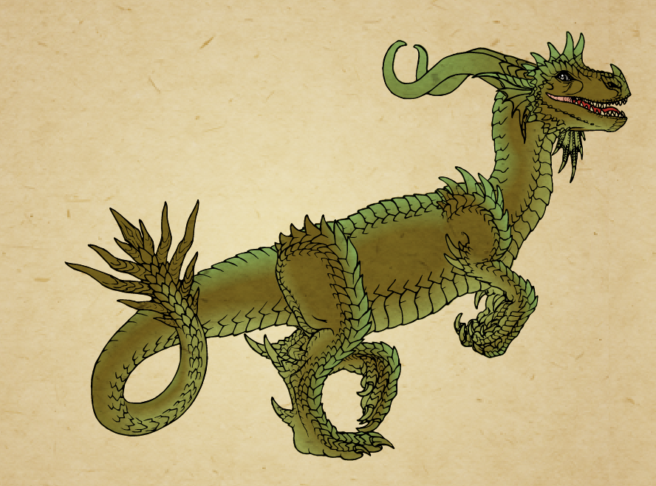
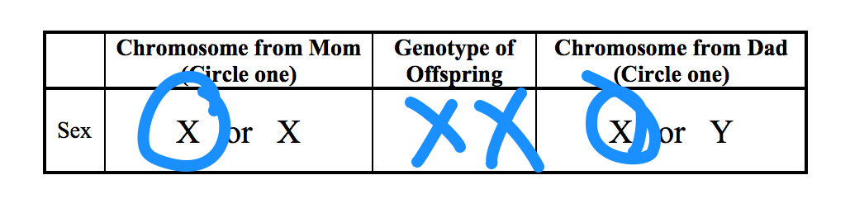
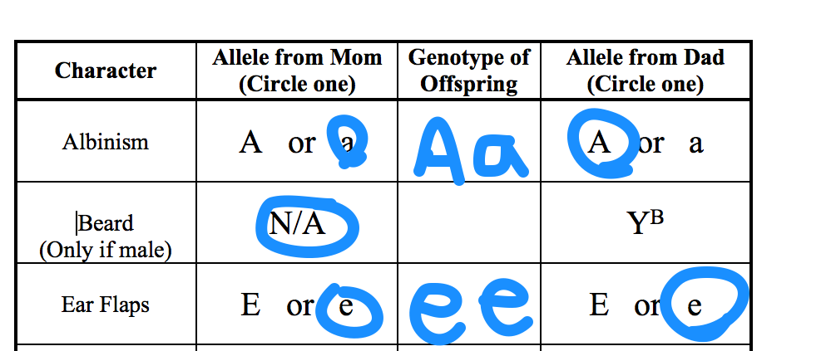
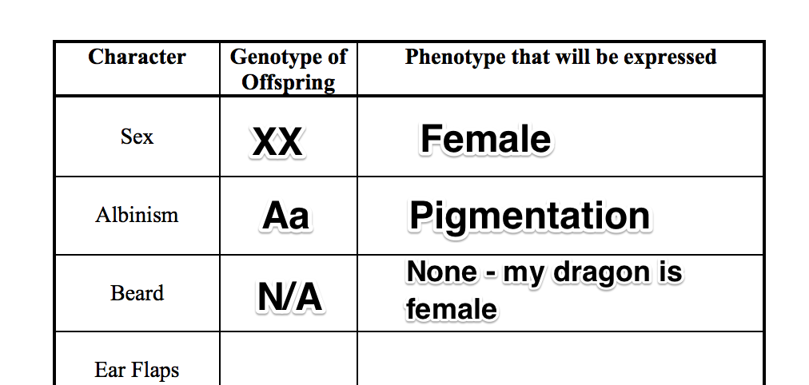
Characters
Bearded
Feathered Wings
Grounded
Long External Ear Flaps
Example
Each item circled represents a single coin flip.
Sex determination:
Selecting alleles:
Phenotype
Now that you’ve randomly selected the baby dragon’s alleles, it’s time to see how your baby is going to look!
Enter the baby’s genotype into the correct column for each character
Consult the Character chart to determine the phenotype that your baby dragon will express for each character
Pay attention to the “Note to Breeders.” There are a few special cases where the genotype for one character will be superseded by a gene at a different locus
Congratulations! You’ve just successfully bred a baby dragon!

Slide 9
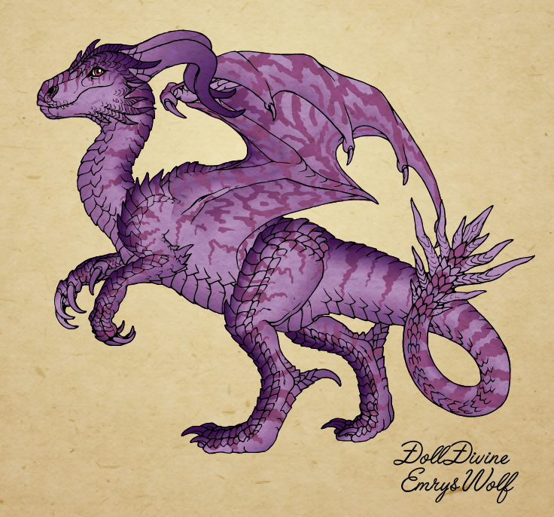
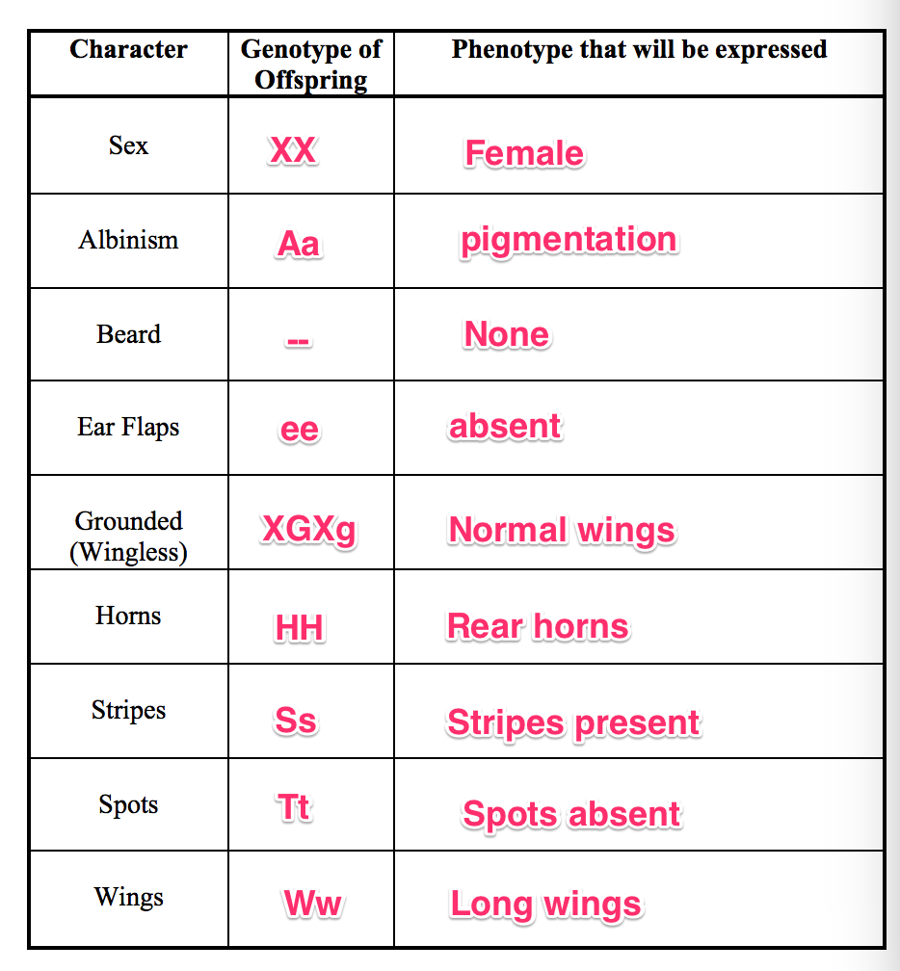
Station 7: Create Your Dragon!
Please create an image of your new dragon that illustrates the correct phenotype for every character we tracked. There are various ways this can be completed.
Draw and color your dragon by hand
Trace, copy, or cut and paste the correct traits from the handout provided. (I can also provide these images digitally, if you’d like to work in Photoshop or GIMP, etc).
Create your dragon online at the Dragon Maker at DollDivine (This is the option I recommend – the artwork is really cool).
http://www.dolldivine.com/dd-dragon-maker.php
When creating an image, feel free to use your imagination, as long as the dragon has the correct phenotypic traits.
You can use any, neck, arms, legs, or tail design
You may use any combination of colors for the body, stripes or spots that the dragon may have inherited, unless your dragon is albino. Albino dragons will be pure white, with no stripes or spots even if they inherited those traits from a parent.
Only choose a head with a nose horn if your dragon inherited that trait
If you are working with a partner, even though you can both have the same phenotypes for your dragon, you’ll need to each make your own individual image. You can submit a digital image (for example, a screen capture from the Dragon Maker site) as an email, to stjohnw@sonoma.edu.
I’m looking forward to seeing your dragons!
Follow up Questions:
We’re almost done with your first adventure as a dragon breeder. Please complete the follow-up questions in the worksheet. If you’re fuzzy about some of the answers, you should find the information you need in my inheritance lectures.

